Slide 1
SCHEDULED CASTES/SCHEDULED TRIBES CELL NIT ANDHRA PRADESH

Slide 2
ESTABLISHMENT OF SC/ST CELL
The SC/ST Cell, a statutory body has been constituted in September 2018 by the Ministry of Human Resource Management (MHRD), Government of India (GOI) in the NIT Andhra Pradesh to safeguard the interests of the SC/ST students and employees of the Institute as per the instructions of MHRD, GOI from time to time.
FUNCTIONS OF SC/ST CELL
Grievances redress for the grievances of SC/ST students and employees and render them necessary help in solving their academic as well as administrative problems.
Promotes higher education among the SC/ST or weaker communities that are suffering from economic, social and educational deprivations.
Continuously monitors and evaluates the reservation policies and other programs intended for SC/STs by the Government of India for their effective implementation at NIT Andhra Pradesh.
Suggests the follow-up measures to the administration of the Institute for achieving the objectives and targets laid down by Ministry of Human Resource Development for the empowerment of SC/STs.

Slide 3
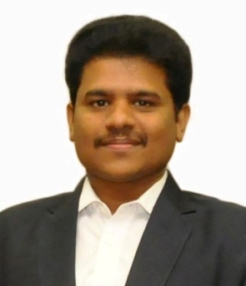
RESPONSIBILITIES OF SC/ST CELL
Coordinating scholarship schemes for the benefit of the students belonging to SC/STs.
Special coaching for SC/ST students.
Conducting/Coordinating training programmes for students and staff (Teaching and Non-Teaching).
CONTACT PERSON
Dr. VINOTH KUMAR RAJA
Coordinator
SC/ST Cell - NIT Andhra Pradesh
E-mail: scstcell@nitandhra.ac.in
Webpage: http://www.nitandhra.ac.in/main/scstcell

Slide 4
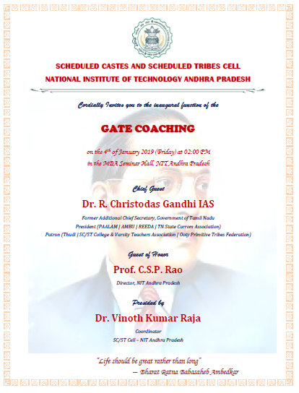
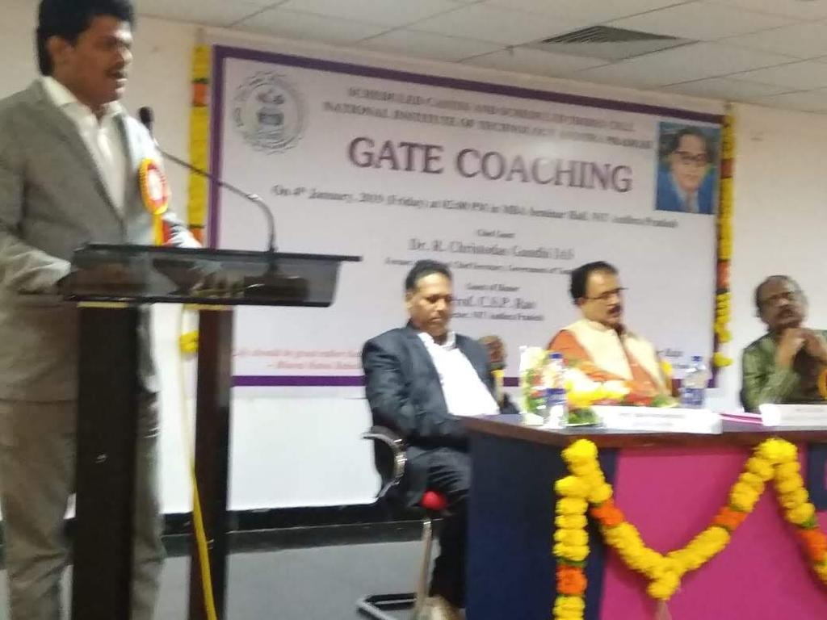
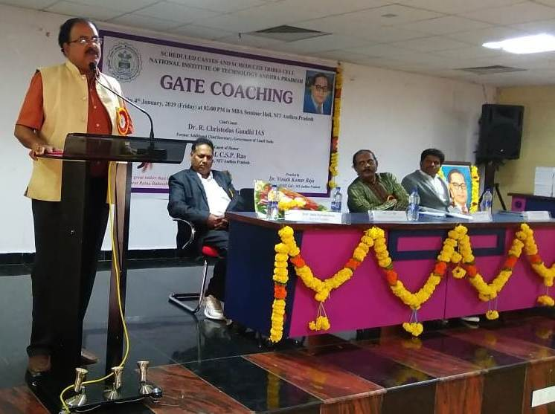
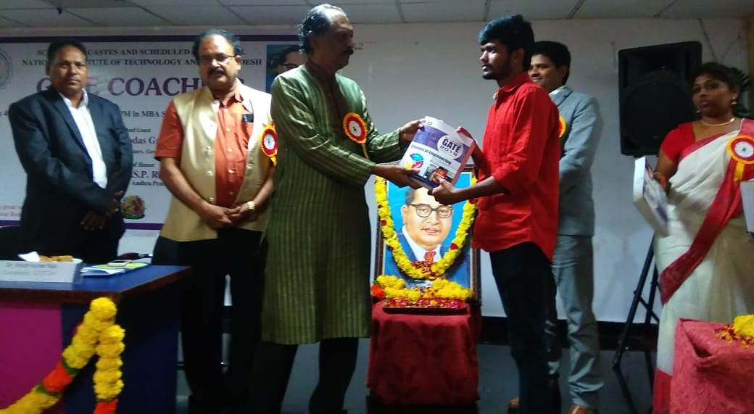
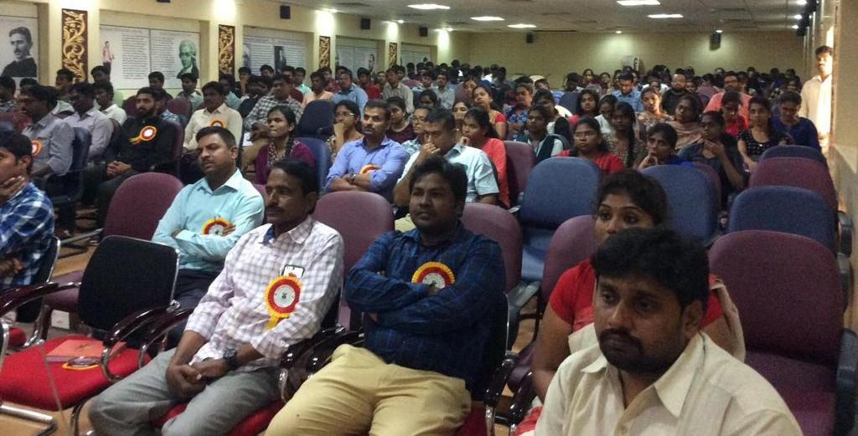
PROGRAMS ORGANIZED BY SC/ST CELL
On 4th January 2019, Inaugurated Free Coaching for GATE2019 to all final students of NIT Andhra Pradesh and SC/ST students from other engineering colleges located in West Godavari district.
Address by Coordinator Dr. Vinoth Kumar Raja
Inaugural Address by Director Prof. CSP Rao
Free Study Materials Distribution by Chief Guest Dr. Christodas Gandhi IAS
Assembled GATE Aspirants and Faculty Members

Slide 5
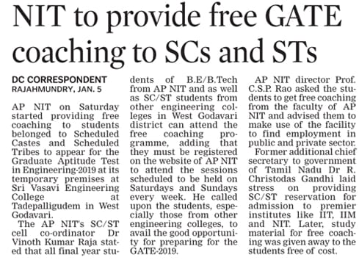
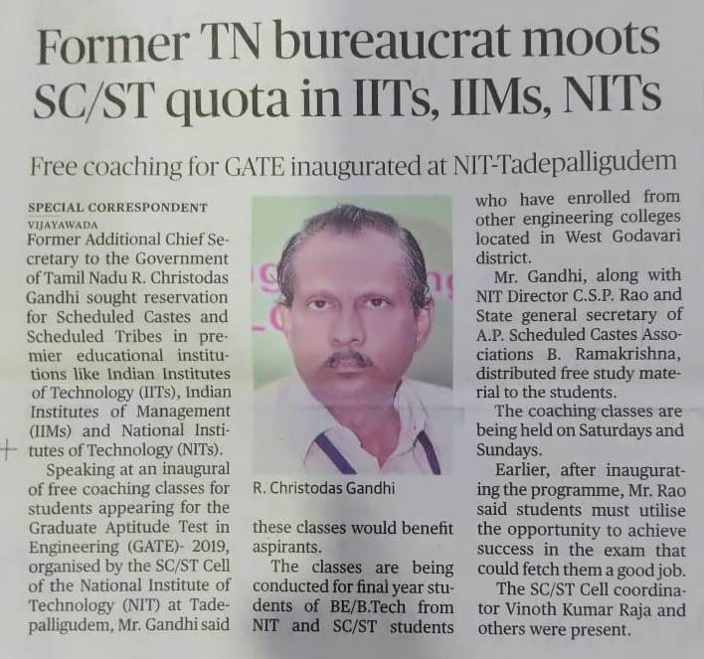
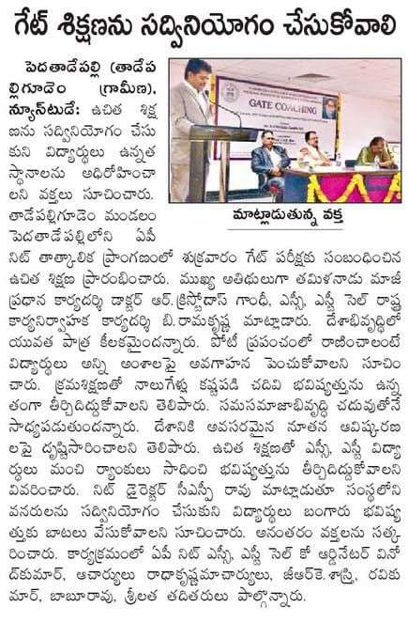
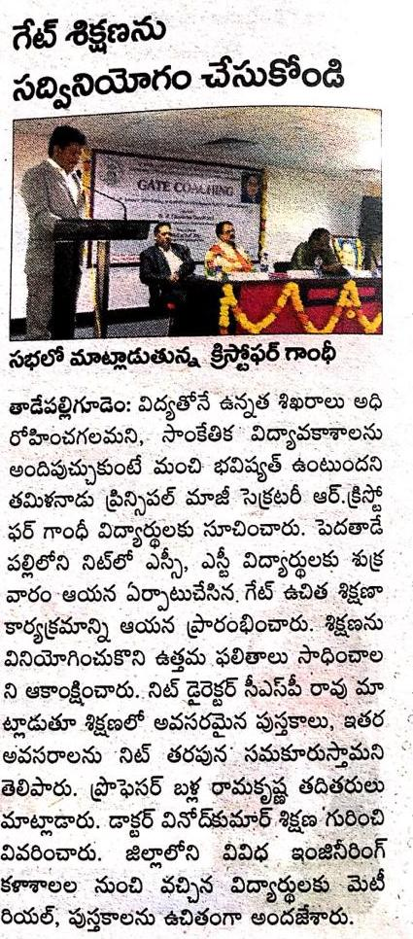
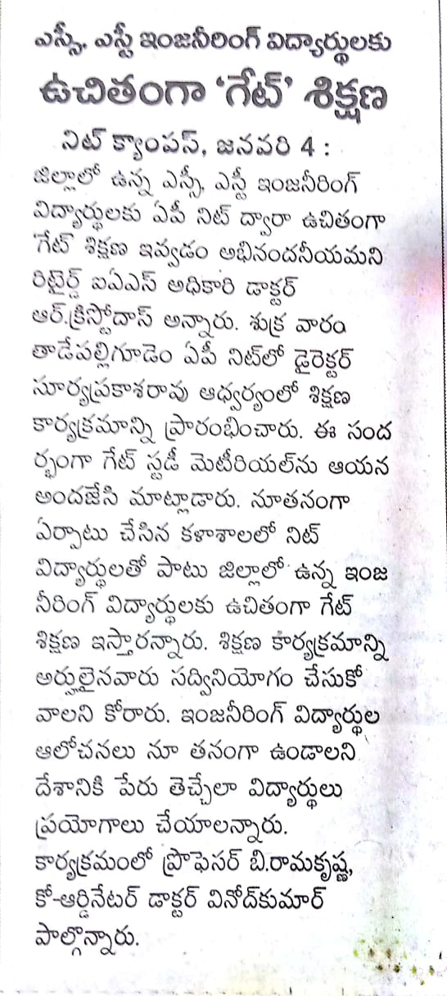
HIGHLIGHTS IN NEWS MEDIA

Slide 6
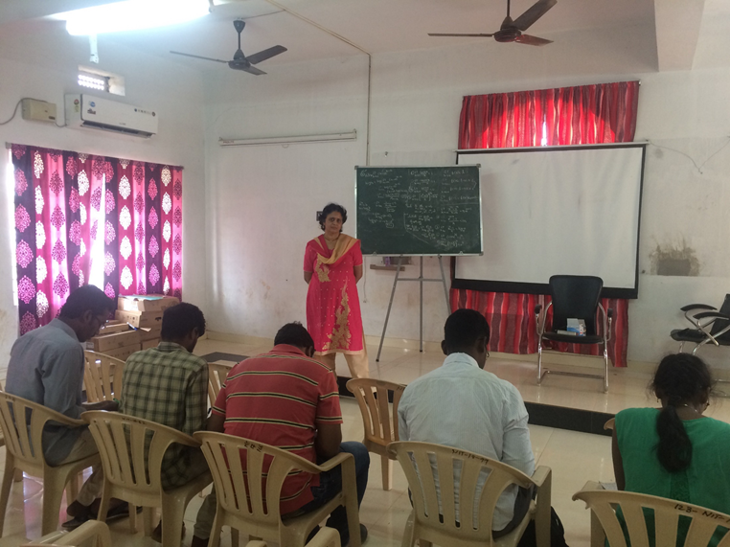
GATE 2019 Free Coaching by SC/ST Cell of NIT Andhra Pradesh

